Slide 1

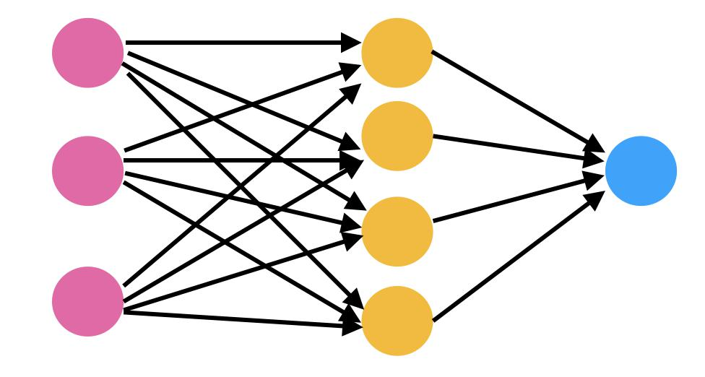
Loan Approval Rates
5-7-2025
Joseph Struessel

Slide 2

Defining the Reason
Getting an idea of what could possibly gain you a loan and how much you could possibly get can be helpful for businesses and others needing money.

Slide 3
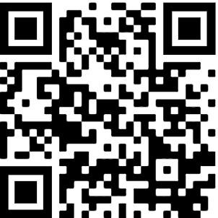
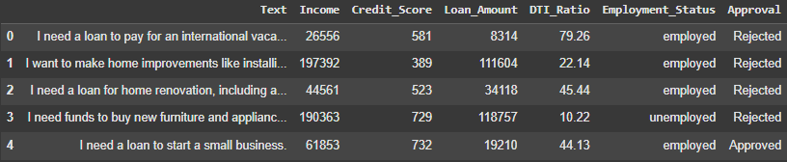
The Data
https://raw.githubusercontent.com/jstruessel/loans/refs/heads/main/loan_data.csv
The data I started with had sentences as well as two columns that needed to be transformed to 0 and 1s. The data came with 24000 rows and 7 columns.
Sourced from Kaggle and imported to Github.

Slide 4
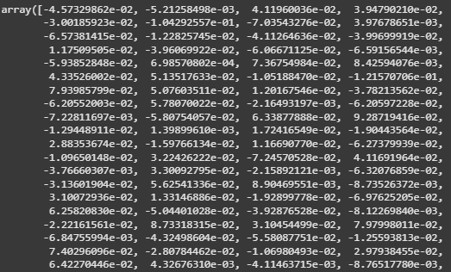
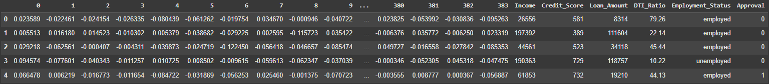
The Prediction
I used transformers to make the sentences to arrays I could use to compare to each other, and then used the new data in a neural network to estimate the approval.

Slide 5
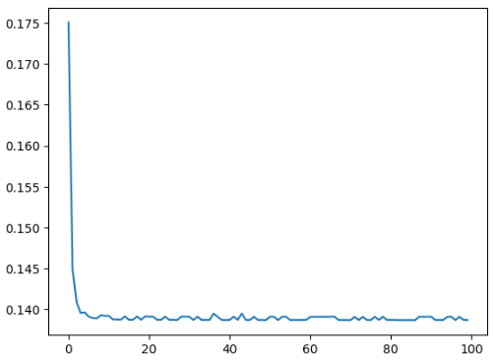
Drawing a Conclusion
After running the epochs we ended up with a loss of .13 giving us a accuracy of 87%.

Slide 6

Appendix
Science Presentation
Even with so much data it only took just over a minute to compute
After the transformation there was 390 columns
The overall approval rate was about 1/5

